Slide 1
Mtc / abag affordable and workforce housing by design: what’s working in the bay area?
SAN FRANCISCO MAYOR’S OFFICE OF HOUSING
and COMMUNITY DEVELOPMENT
2017

Slide 2
SAN FRANCISCO: What we have
HIGH RENTS / SALES PRICES
LOW PRODUCTION
INCOME DISPARITY
FEDERAL DISINVESTMENT
Notes:
Contents of some slides may be offensive – warning!

Slide 3
SAN FRANCISCO’S AFFORDABLE RENT GAP:
100%-150% Area Median Income vs. Market
House-hold Size | 100% AMI | Afford Rent | 120% AMI | Afford Rent | 150% AMI | Afford Rent | 2015 MARKET RENT (Readily available; no rent-control) | Affordability Gap, 100% AMI
1 | 71,350 | 1,784 | 85,600 | 2,140 | 107,050 | 2,676 | 2,695 (studio) | (911)
2 | 81,500 | 2,038 | 97,800 | 2,445 | 122,250 | 3,056 | 3,495 (1BR) | (1,457)
3 | 91,700 | 2,293 | 110,050 | 2,751 | 137,550 | 3,439 | 4,750 (2BR) | (2,457)
4 | 101,900 | 2,548 | 122,300 | 3,058 | 152,850 | 3,821 | 5,800 (3BR) | (3,252)
Notes:
2/3 of Sfians, if they had to get a new place, could not afford to stay in SF

Slide 4
SAN FRANCISCO’S AFFORDABLE OWNERSHIP GAP: 100%-150% Area Median Income vs. Market
Income Levels | Affordable Sales Price | Affordability Gap
150% AMI | $620,000 | ($444,000)
120% AMI | $479,000 | ($584,000)
100% AMI | $385,000 | ($678,000)
Median Home Value | $1,119,000
Notes:
Buying a house is even harder.

Slide 5
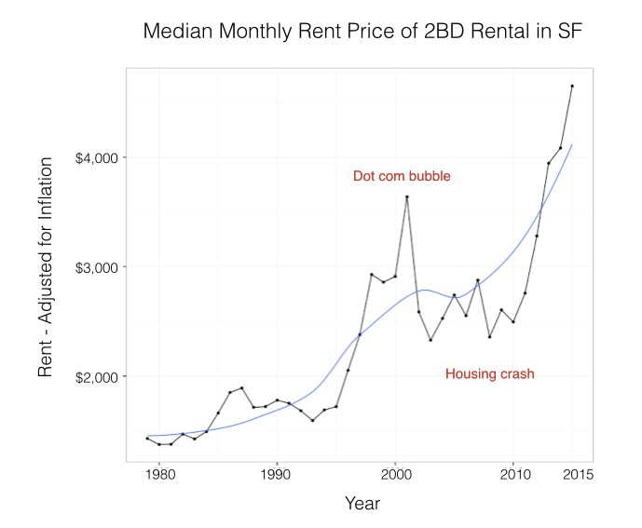
SAN FRANCISCO RENT INCREASES: 1980 – 2015
1980: $1,376 (adjusted for inflation via Bureau of Labor/CPI data)
2015: $4,750 (average 2BR rent, Zumper, SF Rent Board)
Percentage Growth: 245%
https://medium.com/@mccannatron/1979-to-2015-average-rent-in-san-francisco-33aaea22de0e#.bys6yeazw
Notes:
We’re in a particularly difficult time right now. This is truly a crisis that combines explosive job growth, post-recession, increased population, historically low production and not enough supply vs. high wages in the Bay Area.

Slide 6
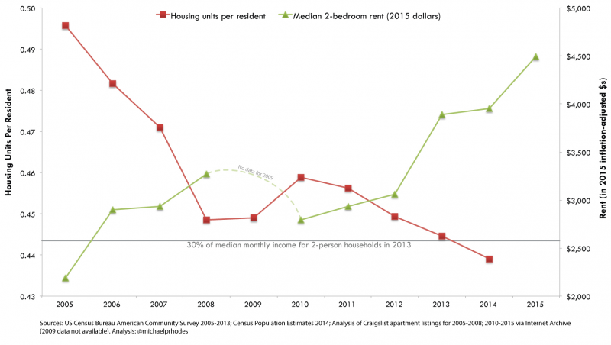
SAN FRANCISCO’S HOUSING SUPPLY AND PRICING: 2005-2015
Notes:
And here we have the basic supply and demand graph, which explains a lot about why housing has become so vital to our policy discussions.

Slide 7
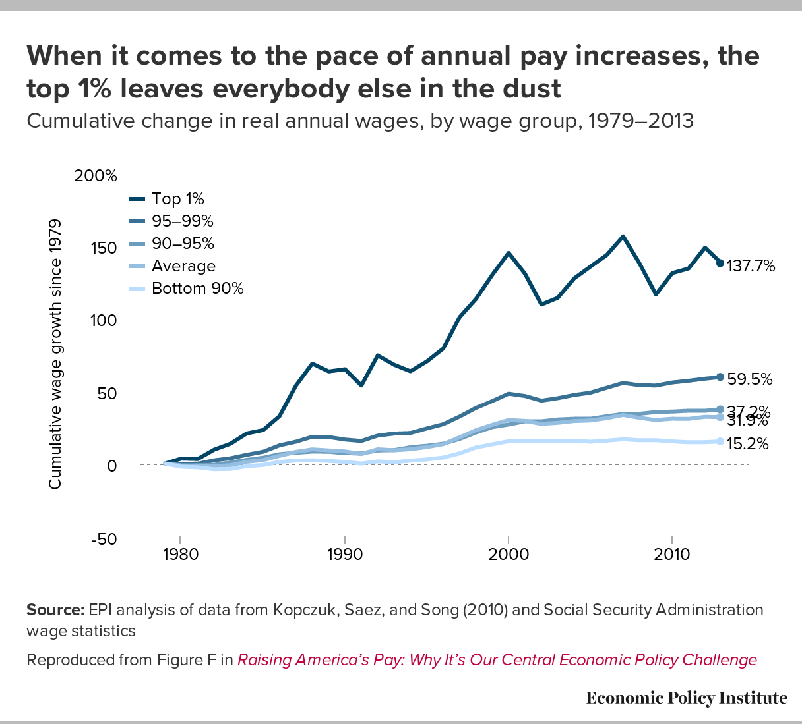
WAGE GROWTH BY INCOME GROUP, U.S. 1980-2010
Notes:
Working household wages since 1978 have basically been flat, while the top 5% of American wage earners have captured the value of the country’s financial growth and increased productivity.

Slide 8
Notes:
The most powerful tool we have for building and preserving affordable housing, the low income housing tax credit, is dwarfed by the subsidies we provide higher-income homeowners.

Slide 9
San Francisco’s response
NEW AFFORDABLE DEVELOPMENT
AFFORDABLE HOUSING PRESERVATION
HIGHER DENSITY
LEGISLATIVE ACTION
Notes:
Contents of some slides may be offensive – warning!

Slide 10
SAN FRANCISCO’S RESPONSE
#1: PRODUCTION: 10,000 new/preserved units by 2020
  Local Housing Trust Fund guaranteed financing
  Strong inclusionary zoning & neighborhood fees
  Public Lands for Housing laws
#2: PRESERVATION
  “Small Sites Acquisition Loan Program” (2014)
  Provides BMR financing to developers to acquire/rehab rent-controlled buildings
  Prevents displacement / stops vacancy decontrol & conversion to market rents

Slide 11
SAN FRANCISCO’S RESPONSE, continued
#3: DENSITY: AFFORDABLE HOUSING BONUS PROGRAM (2016)
  Allows 3 extra stories for 100% affordable developments
  Market-rate AHBP legislation pending
#4: LEGISLATIVE ACTION
  E.g., “Teacher Housing Act of 2016” (SB 1413): allows California school districts to use district property for teacher housing and addresses fair housing concerns, enabling access to low-income housing tax credits

Slide 12
Status – Production / Preservation:
Q1 2014 – Q3 2016:
4,001 Acquisitions / Rehabs complete and in construction
1,767 new construction units complete and in construction
Total: 5,768 (58% toward goal)
Moving forward: Of 4 new 2015 bond-funded developments, 3 must undergo full EIR

Slide 13
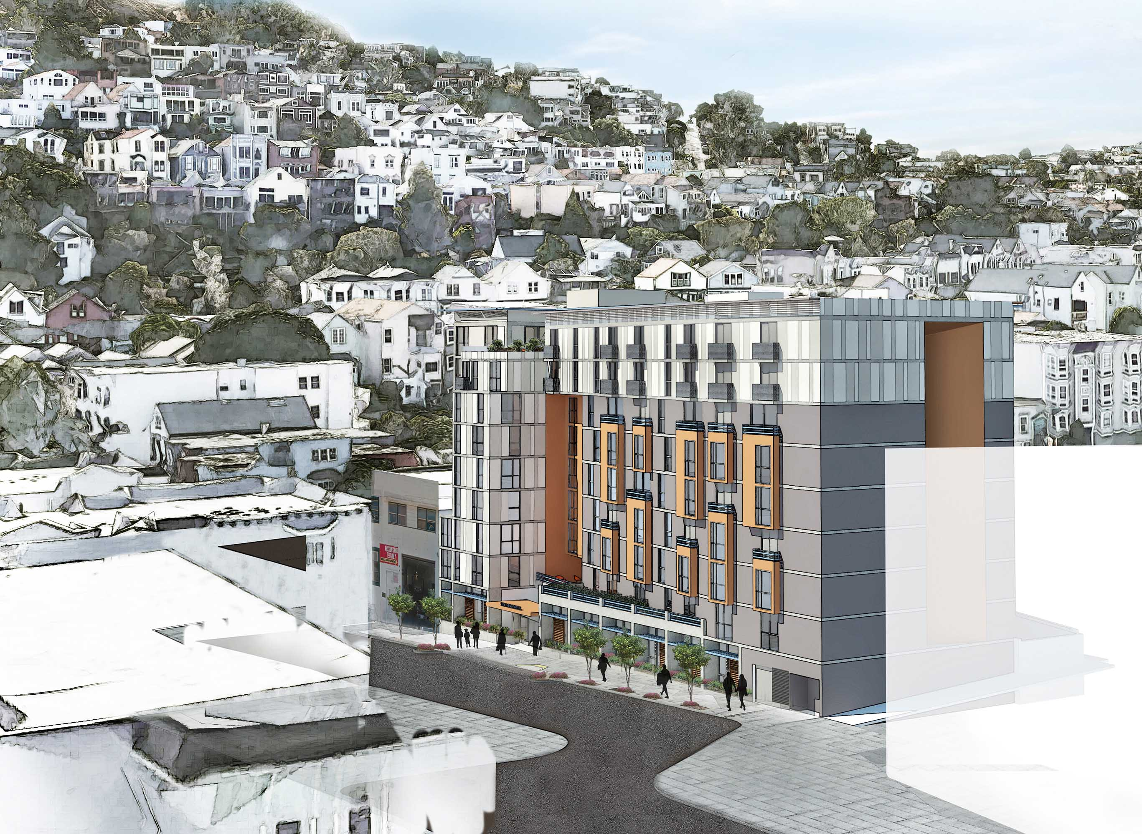
Status – Density:
First Affordable
Housing Bonus development,
1296 Shotwell, unanimously
approved by City Planning
Commission, November 2016.
Neighbors filed CEQA appeal
January 2017.

Slide 14
Status – Legislation:
Teacher Housing: in discussions with SFUSD
Additional legislative action pending:
  Governor’s legislative package call: reduce regulatory barriers, reward localities approving housing with funding & other incentives
  AB 71: divert state mortgage interest deduction on vacation homes to state housing tax credits ($300M)
  AB 72: State AG enforcement of localities’ housing obligations
  AB 73: incentive payments for upfront TOD zoning districts
  AB 74: provides Medi-Cal rental assistance for chronically homeless housing

