Slide 1
MTC Planning Innovations
Affordable and Workforce Housing
Kevin Griffith
BRIDGE Housing Corporation

Slide 2
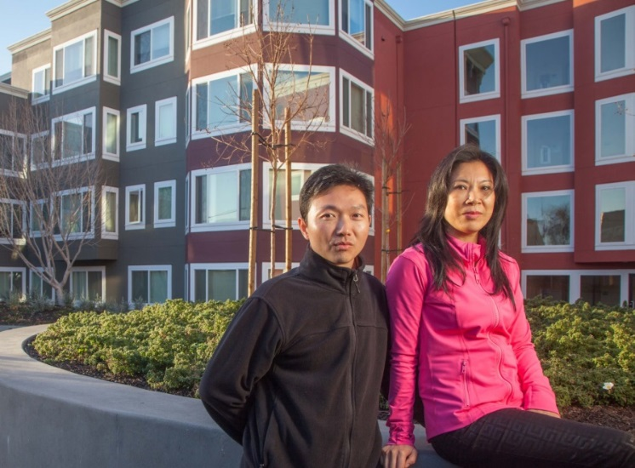
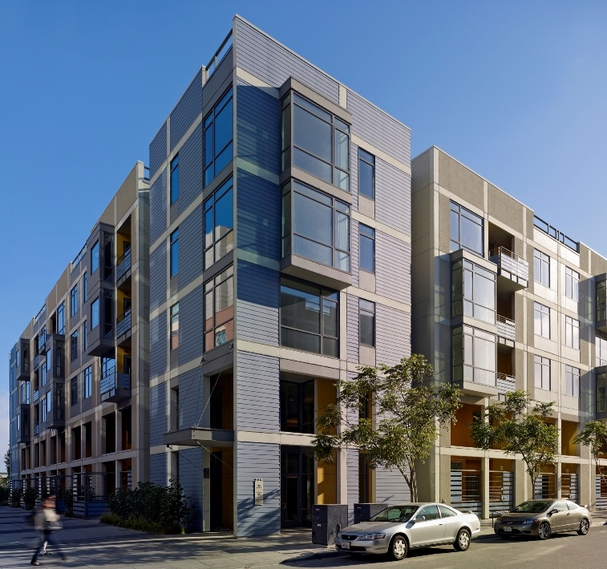
About BRIDGE
Mission-Driven Business
  Quantity, Quality, Affordability
  Primarily Affordable Housing, but also Mixed-Income Housing
  Master Developer of Large Multiphase Communities
Results
  14,000 homes completed
  60+ cities and towns served in California and the Pacific Northwest
  40,000 people live in high-quality housing today as a result of our work

Slide 3
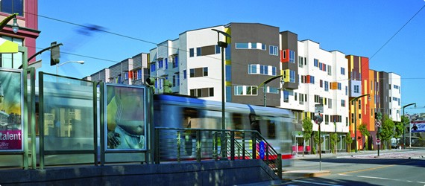
Our Broken Housing System
  Who is the market serving?
    Programs assume a functioning housing market
  The Problem
    Much easier to add jobs than housing units
    Hurdles to approvals, CEQA etc.
  The Politics
    Anti-housing Culture
    Interest groups benefit from current system
    Little political upside for change

Slide 4
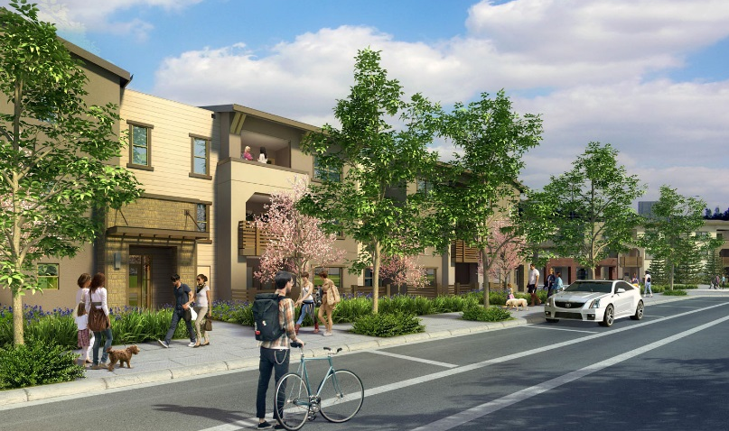
Our Broken Housing System
  The Consequences
    Commutes and associated pollution
    Gentrification
    Decrease in social mobility / increase in segregation
    Vital workforce priced out

Slide 5
Some Hope Going Forward
California Cities and Counties passed over $3 billion in new housing funding last year
State level funding for affordable?
  SB 2 (Atkins) Document recording fee
  AB 71 (Chiu) Reduction in mortgage interest deduction for vacation homes
Streamlining Approvals (Housing “By-Right”)
  Governor's Proposal
  SB 35 (Weiner) – streamlined approvals apply in Cities that are not meeting their State housing goals
  Labor-Environmental coalition statement
YIMBY Movement

Slide 6
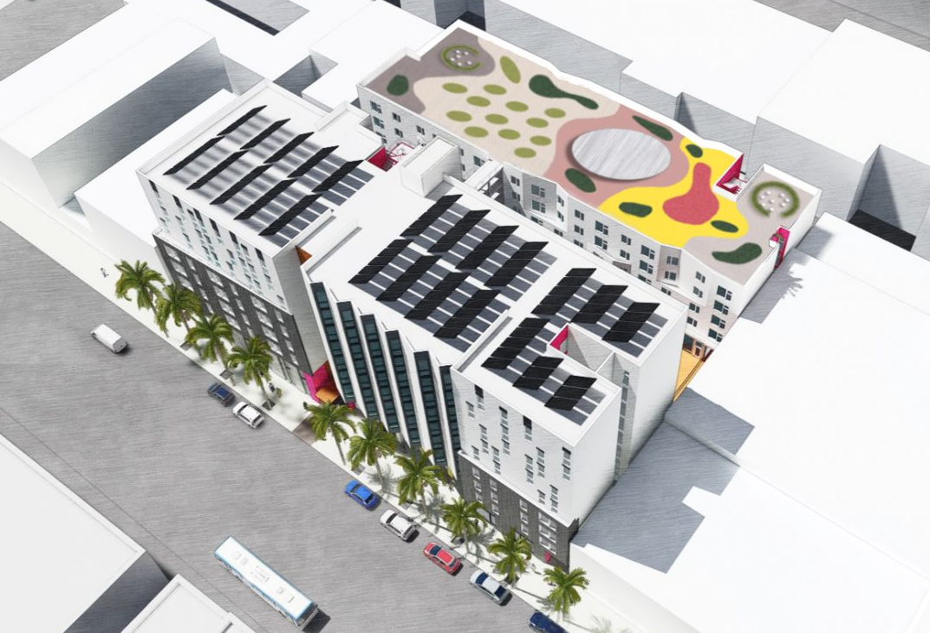
Tools Localities Have to Support Affordable Housing
  Put publicly owned sites in to production
  Accelerate approvals
  Area Plans with Programmatic EIRs
  Flexibility on development standards (especially parking).
  Leverage market rate housing and (especially) commercial development to include or fund affordable
  Funding – Bond measures, etc.

Slide 7
Case Study – San Francisco Infill Site
San Francisco neighborhood
1.4 acres, commercial corridor, superior transit
Large site, opportunity for mix of housing, ideal infill location

Slide 8
Case Study
Through Lot – opportunity to subdivide
114 affordable rental units
20 for-sale townhomes
Community Health Clinic

Slide 9
Case Study – City Support
Affordable Housing Bonus Program
  Allows additional three floors – we are utilizing two.
Zero Parking
Priority Processing
City funding from Housing Bond

