Slide 1
REGIONAL ACTIVE TRANSPORTATION PLAN
September 9, 2021
Local Streets and Roads
& Program Delivery Working Groups

Slide 2
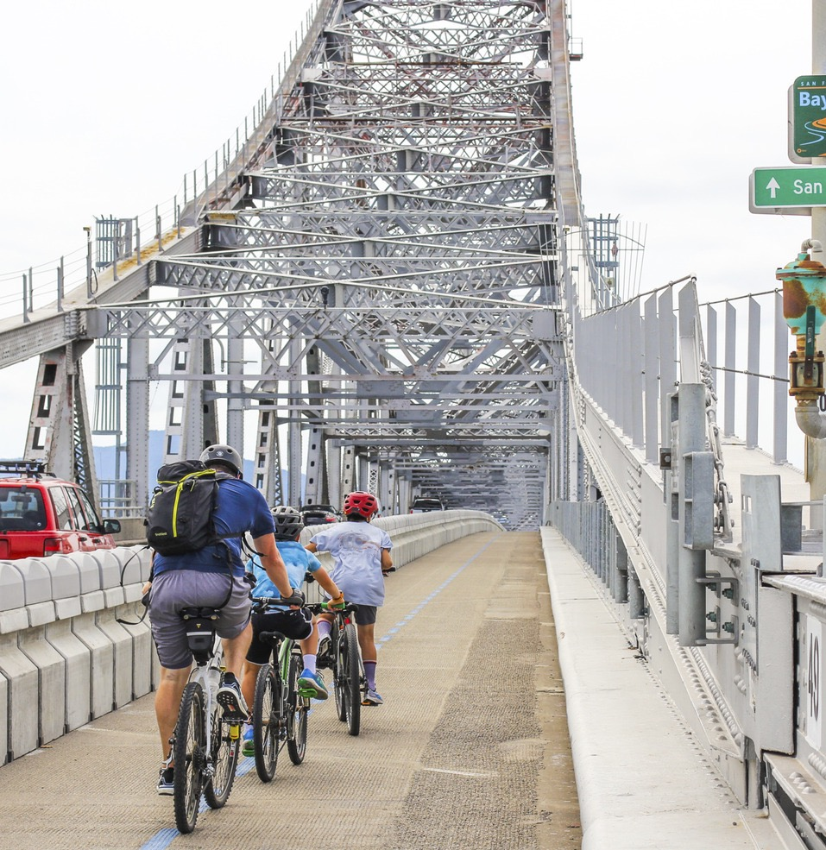
AGENDA
Plan Bay Area and the AT Plan
Scope and Timeline
Draft Vision
Complete Streets
Policy Update
AT Network
Funding Assessment
Notes:
Today, I’ll provide an update on the Active Transportation Plan, or the AT Plan for short. Starting at the highest level of its connection to Plan Bay Area, then the scope, timeline and draft vision. The last three items will be the main tasks which include the CS Policy Update, AT Network and Funding Assessment.

Slide 3
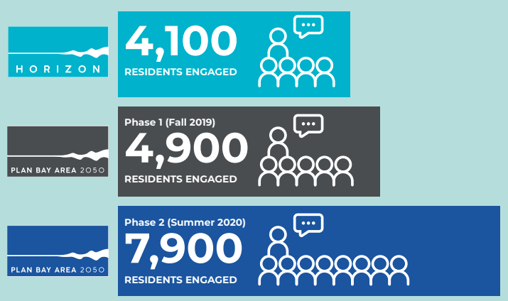
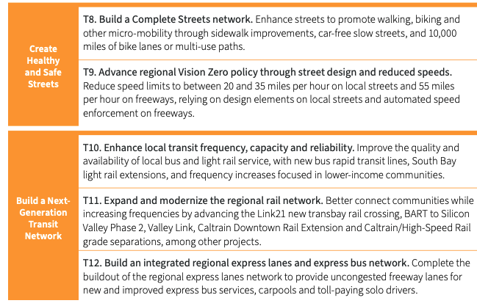
Plan Bay Area and the AT Plan
Notes:
The draft Plan Bay Area 2050 has been released, with a scheduled adoption in October. This planning process has been taking place for over 3 years and engaged over 14k residents. Through this plan, 35 bold strategies have been proposed to help meet PBA goals for the environment, economy, housing and transportation. The “Create Healthy and Safe Streets” theme is what the AT Plan is working from, specifically T8 Build a Complete Streets Network, as well as advancing regional VZ policy.

Slide 4
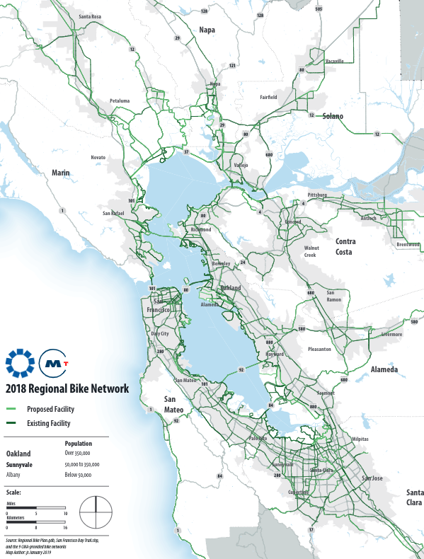
AT Plan Scope
Stakeholder Engagement supplemented by TAC and paid CBO outreach
Policy and Program analysis, with focus on Vision Zero and equity and includes an update of MTC’s Complete Streets Policy (Resolution 3765)
Development of Regional Active Transportation Network, rebranded from PBA’s Complete Streets Network strategy built off of Regional Bike Network
5-Year Implementation Plan (IP), in coordination with PBA 5-Year IP
Funding assessment to understand funding constraints and potential funding scenarios to implement the Plan
Notes:
The plan has 5 tasks, and you can see the PBA overlap in tasks 2 and 3. We are finalizing the stakeholder engagement now and incorporating this into the Policy and Program analysis and the development of a Regional AT Network. The AT Network was rebranded from PBA’s CS Network to highlight that paths will be included in this 10k mile network. We will also build off the Regional Bike Network (established during the 2001 Bike Plan) as well as all the applicable county and Caltrans AT plans, and the BATC (Bay Area Trails Collaborative) network.
Background for Q&A
Policy/Program Analysis – reviewing AT plans and policies from around the region to understand the policy landscape as it relates to AT and micromobility and how these policies affect vision zero, climate change, green infrastructure, and equity.
Implementation Plan – The Plan has a 30-year planning horizon to align with PBA 2050 with more detailed 5-year IP to include AT Network, policy and funding. Will be closely coordinated with PBA IP and Also will include next steps for the Bicycle and Pedestrian Count Program
Funding Assessment – being led by MTC – will include applicable funding sources, constraints and potential funding scenarios

Slide 5
AT Plan Timeline
TAC
Committee, CBO, Agency Engagement
Webmap
Project Initiation
Policy Analysis & Data Assembly
Network Development & Implementation Plan
Finalize Implementation Plan &
Develop AT Plan
Apr-May
Jun-Aug
Sep - Dec
Jan - Jun
Develop Stakeholder Engagement Plan
Establish schedule
Coordinate data
Assemble data
Review Relevant Policies
Aggregate network data
Complete Streets Policy Recommendations
Identify regional AT network and gaps
High-level 5-year implementation plan
Refine 5-year implementation plan
Create AT Plan
Notes:
14-15 month timeline
4 phases
We’re currently in the Network Development phase, or the 3rd phase.
Working to adopt plan by end of June 2022

Slide 6
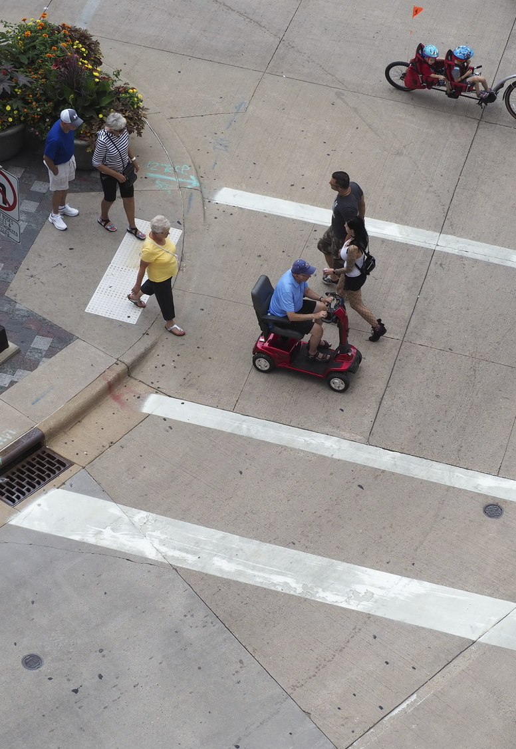
AT Plan Vision
We envision a Bay Area where many more people walk, bike and roll everyday on safe, accessible, and connected streets, paths and trails to get to people, places and transit.
Notes:
We’ve met with many stakeholders and have come to this vision.

Slide 7
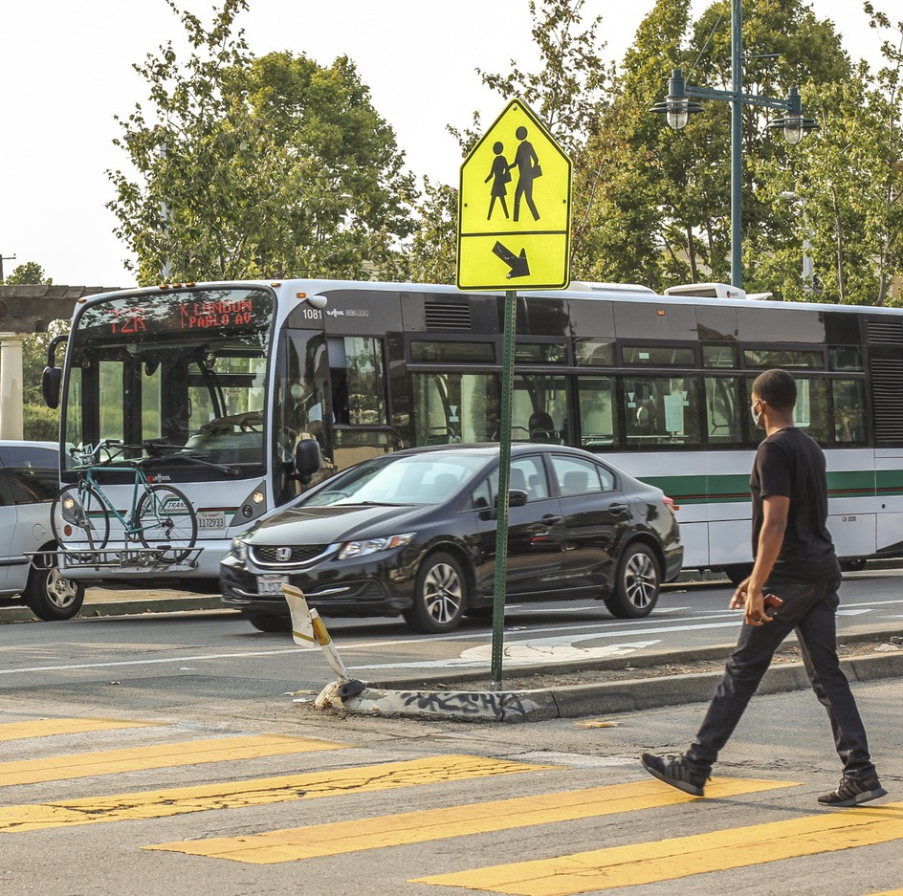
Complete Streets Policy Update
Task Overview
Policy and Program Analysis
Review Resolution 3765/Engage Stakeholders
Propose updates
Updated Complete Streets Policy & Checklist
Notes:
MTC’s Resolution 3765 or Routine Accommodation for Bicycle and Pedestrian Facilities, also known as MTC’s Complete Streets Policy, was adopted in 2006. A lot has happened in the bike ped field as well in the Bay Area since then, and its time to update it with a Vision Zero and equity lens. Toole Design Group, the lead consultant, has reviewed a diverse subsection of plans and policies across the region, completed comparison with the policy to the National Complete Streets Coalition and is incorporating stakeholder engagement into a proposed policy update. This draft update will be shared at the next Active Transportation Working Group this fall and updated in time to be included in OBAG 3.

Slide 8
Network Criteria - Development Process
Key steps in development process:
Adopted county and Caltrans D4 plans*
  Analyze bike, pedestrian, and/or active transportation plans to see where regional bicycle infrastructure and high priority pedestrian improvement areas are located.
  Understand where regional bicycle infrastructure gaps are located.
Regional Bikeway Network (RBN)*
  The RBN (and county plans) will serve as the backbone of the AT Network.
Regional Planning Framework
  Connect certain components of MTC’s mobility hub framework
  PDAs, Equity Priority Areas, etc.
  BATC network
Stakeholder Engagement
  Will be used to establish and refine network criteria (Web map)
  Will help define the regional AT network and what constitutes a gap for both bicycle and pedestrian networks.
* Updated data is currently being collected by MTC GIS team
Notes:
In addition to the CS Policy, is the identification a Regional Active Transportation Network.
The Network will begin with identifying and expanding upon the RBN
Then work with stakeholders (TAC) to determine and refine network criteria (what we have so far)
Incorporate some concepts from the MTC Mobility Hub framework to the network criteria

Slide 9
Network Criteria – Objectives
Objective | Measure
Regional Planning Framework | Connect people to areas that will have future growth in housing, jobs, and transit over the next 30 years identified in the Bay Area Blueprint 2050 plan.
Safety | Create or maintain a safe environment for people walking, rolling, and riding a bike.
Equity | Provide active transportation options to communities with the most vulnerable populations who may face higher levels of burden.
Connections | Provide connections to key regional destinations or corridors.
Previous Planning Efforts | Build upon regionally significant planned projects that have been identified through local and county planning efforts.
Notes:
Here are the Network Criteria and objectives. Developed 5 general categories for the network criteria that align with regional priorities and will help advance the region to meet Plan Bay Area 2050 goals.
Within these 5 categories are specific measures or values that will be discussed in detail in this presentation.

Slide 10
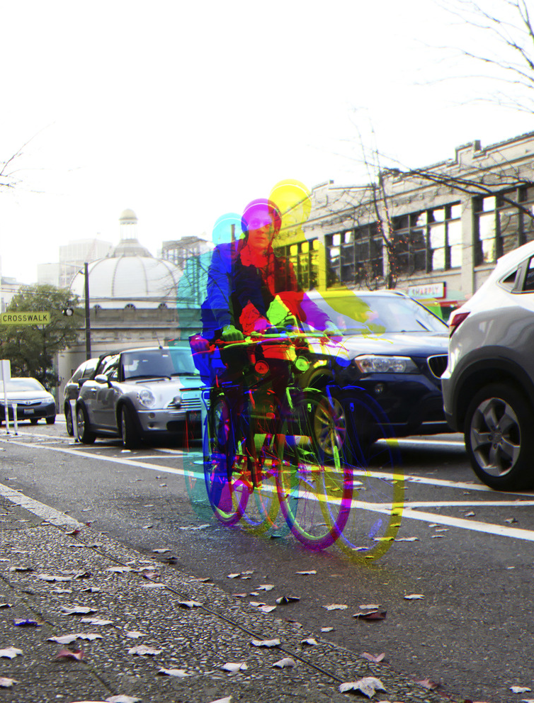
AT Network Criteria Discussion
Are we missing any important criteria?
What would you consider priority criteria?
PBA calls for 10,000 mile network of bike lanes and multi-use paths – what portion may be regional vs. local?
Notes:
Now we’d like to hear from you. Are we missing any important criteria. What would you consider priority?...
(Background)
BATC – 2,500 miles (includes hiking trails)
RBN – 2,600 (1,400 existing)
-Napa Co – 500 miles

Slide 11






Funding Assessment
The Funding Assessment will identify funding sources and scenarios to build out a regional active transportation network & implement the AT Plan, while helping to make it easier to access, apply, win, allocate and report back on active transportation programs.
AT Funding Inventory
AT Funding and Complete Streets Policy Survey
Notes:
Last but definitely not least is the staff led Funding Assessment. The Funding Assessment will identify funding sources and scenarios to build out a regional AT Network and implement the AT Plan while helping to make it easier to access, apply, win, allocate and report back on AT Programs. So far we have completed a AT Funding inventory, and an AT funding and CS Policy Survey, both completed with help from CTAs.

Slide 12
Survey Findings
Most used funding programs for maintenance:
Local Sales Tax
General Agency Funds
Biggest challenges to securing funding:
Application (difficulty & staff capacity)
Not enough funding
“Too competitive”
Limited Program support for small projects
MTC Support:
Application Feedback
Narrative & Writing Assistance
Access to MTC Consultant Benches for
Grant Writing & Planning
1-on-1 Technical Assistance
Most used funding programs for AT Projects:
OBAG
Local Sales Tax
SB1 Local Streets and Roads Program
TDA3
General Agency Funds
CA State Coastal Conservancy
Notes:
Here are some of the survey findings…
Does anything seem surprising to you? Anything that’s missing?

Slide 13
Next Steps:
Active Transportation Working Group meeting in November
TAC Meeting in October
MTC Planning and ABAG Admin Committee, November 14
Propose Complete Streets Policy Update for OBAG 3 Guidelines
Create and Share Draft AT Network

