Slide 1

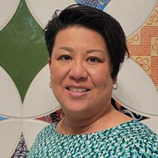

Priority Development Area (PDA) Program Orientation
Dec. 12, 2023
Cheryl Chi, Funding Manager
Manuel Ávalos, Program Coordinator
Notes:
Cheryl
PDA Program Orientation. December 12th, 2023. Metropolitan Transportation Commission. The MTC logo is seen in the lower left corner and on the right.
Images and titles for Cheryl Chi and Manuel Ávalos, the two presenters are show in the lower left.
Hi, In lieu of a round of introductions, could everyone put the name and organization in the chat?
We would also like to record this presentation to make it available to those who may have missed this information and possibly to post on the web. Please let us know if anyone has any objections to that. We will not record the Q&A following the presentation.
Thank you for joining us for the Priority Development Area (PDA) Program Orientation. I am Cheryl Chi, the Housing and Local Planning Funding Manager. I am joined by my colleague, Manuel Ávalos who supports the PDA program and the Regional Housing Technical Assistance Program. We will be presenting the information today. We are also joined by our colleagues Ada Chan, a regional planner at MTC/ABAG, Daniel Saver, the head of our unit, Housing and Local Planning Team, Michael Brinton, the head of our Contracts Unit, as well as a member of his team, Ryan DeCoud, Contract Compliance Manager. They are also here to answer any questions you may have.
Please feel free to post questions in the chat and we will try to address them as we go. There will be ample for questions at the end of the presentation.
I would like to begin with a land acknowledgement (Source: Plan Bay Area 2050).
The land that makes up the nine-county San Francisco Bay Area has been home to diverse groups of Indigenous peoples with unique cultures and deeply rooted relationships to the land for over 10,000 years. The Metropolitan Transportation Commission (MTC) and Association of Bay Area Governments (ABAG) acknowledge the Ohlone as the traditional caretakers of the land that makes up the Bay Area. We honor their connection to the land and the deep respect they hold for this region. MTC and ABAG are committed to furthering meaningful partnerships with the tribes of this region.

Slide 2
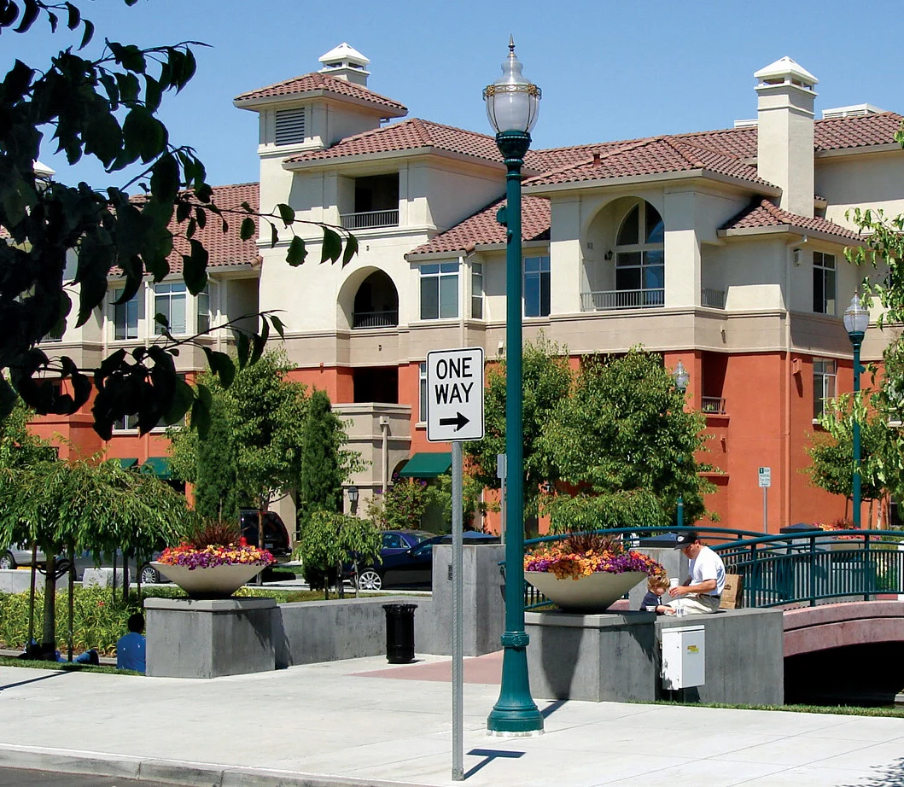
Agenda
Program Overview
Federal Role
Invoicing and Close-Out
Notes:
Cheryl
This is the agenda for this orientation. It is dividing into three sections: 1. Program Overview, 2. Federal Role, and 3. Invoicing and Close Out.
Image description: an image of the Bay Meadows apartment complex in San Mateo. The building appears to be 3 or 4 stories high and is white on top and orange on the bottom. The MTC logo is in the bottom left corner.

Slide 3
Program Overview
Program Background
Contract/Agreement Process
MTC Program Requirements
Notes:
The first section provides a brief overview of the PDA program, MTC processes, and requirements.
Image description: The MTC logo is seen in the lower left corner.

Slide 4
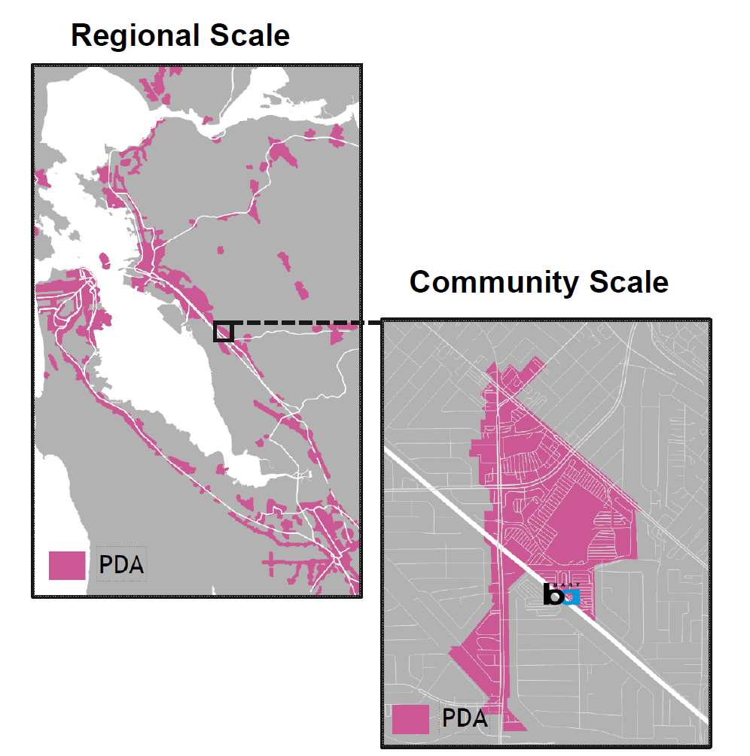
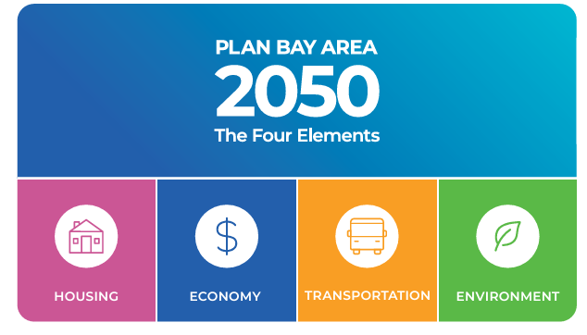
PDA Program: Background
PDA Program supports implementation of Plan Bay Area 2050
Funds plans, plan amendments, and technical assistance
Notes:
First a little background and grounding. MTC is responsible for developing a long-range plan in compliance with federal and state requirements. The long-rang plan, Plan Bay Area 2050 (or PBA) outlines a roadmap for the Bay Area’s future that is affordable, connected, diverse, healthy and vibrant. There are 4 elements of the Plan (Housing, Economy, Transportation, and Environment). The Priority Development Area Program supports implementation of strategies under the housing, transportation, and environment elements. Your PDA project plans an important role in implementing the plan by planning for or furthering implementation for a variety of housing types and densities and complete streets around transit.
Fun facts: 9 rounds of grants. Your project is part of Round 9. To date, there have been more than 80 grants to more than 50 cities.
Now I'll hand it over to Manuel.
Image description: On the bottom left, there is an image showing the 4 elements of the Plan Bay Area 2050. On the right, there is an image of the Priority Development Areas in the Bay Area, with the PDAs shown in pink. The map zooms into the Bayfair BART station, showing the PDA more closely in pink. The MTC logo is seen in the lower left corner.

Slide 5
Getting Started (after project approval)
MTC Internal Review
Docusign
Fully Executed
Review MFA
Provide contact information
Agreement Process (4-6 months)
Master Funding
Agreement
Finalize SOW, Schedule, & Budget
Review and approve supplement
Supplement
Reimbursable work may start after supplement is executed.
Invite representatives from MTC and your CTA on the TAC and invite to public events related to project.
Regular check-ins with your MTC project manager.
Notes:
Manuel
In June 2023, the Commission approved your PDA project. After this approval, MTC staff work have been working with you to execute a grant agreement.
The grant agreement has two separate documents that must both be signed—Master Funding Agreement and Program Supplement. The Master Funding Agreement, or MFA is valid for 10 years and contains most of the legal terms that will apply to a contract. However, it is not legally binding without a supplement. A supplement identifies the legal terms from the MFA that apply to the project and other project-specific requirements. It identifies the specific project, scope, total funding, budget and schedule. An MFA must be executed before a supplement can be executed.
Your agency may already have an MFA. If not, you would work with MTC staff to execute an MFA. Concurrently, or if your agency already has a MFA, you will work with MTC staff to finalize a scope of work and schedule for the project.
The PDA project application contained cost, scope, and schedule. However, additional detail may be necessary for the supplement or there may have changes since the project was proposed. MTC staff will work with you to finalize the scope, schedule, and budget. This information is then entered into a DRAFT supplement for your review.
PDA grants are structured as a deliverables based contract.
Once the draft supplement is approved by your agency, the draft supplement is the reviewed by various MTC functional units like the legal department and Finance. The MTC internal review process takes several weeks.
After this review is completed, the supplement will be routed to your designated signatory for signature via Docusign. Be sure to let them know so that they expect to see the link in their email. Once all parties sign, the agreement is considered executed and a copy will be sent back to you for reference. The effective date of the agreement will be identified in the supplement.
Please note the following:
Reimbursable work under your grant should not begin until the supplement is executed.
Representatives from MTC and your county transportation agency must be offered the opportunity to serve on the technical advisory committee. They may or may not choose to participate, based on their capacity – but you have to give them the opportunity. They should also be informed of public engagement events related to the project. Public engagement is an important requirements of the program.
It's good to have monthly check-in with your MTC project manager. That could be a quick email or meeting. Your MTC project manager can be a resource for problem-solving any issues and provides early communication regarding changes to project scope, cost, and/or schedule.
Image description: There is a blue and green graphic describing the Master Funding Agreement process (review MFA, then provide contact information) alongside a parallel supplement process (finalize scope of work, schedule, and budget, then review and approve supplement). The two parallel processes then converge into one process that reads as follows: MTC internal review, Docusign, fully executed. The MTC logo is seen in the lower left corner.

Slide 6
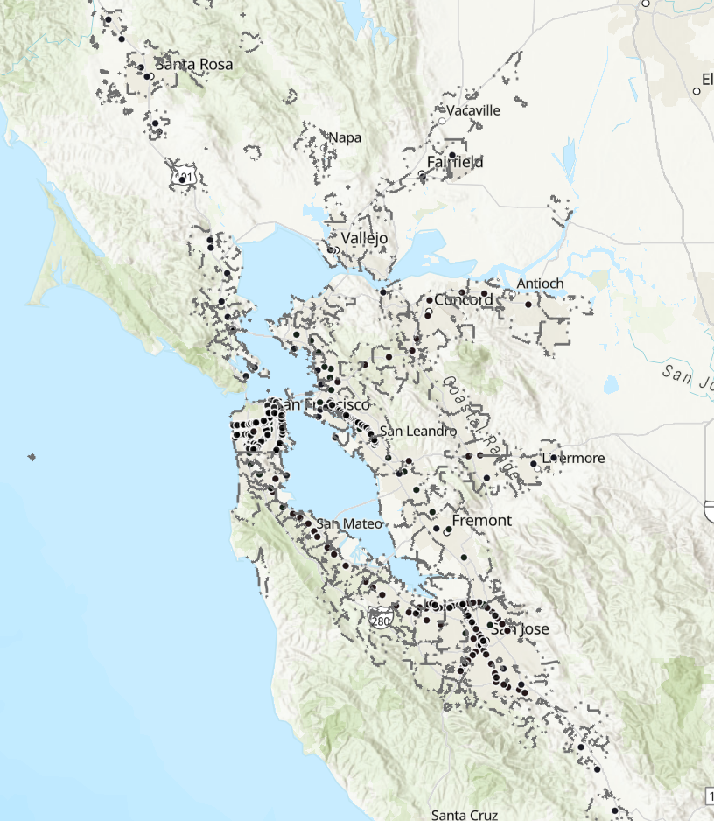
PDA Program Requirements
Key requirements of PDA grants:
Planning Element Requirements
Plan adoption
Relevant regulatory documents, e.g. Zoning Code updated
Programmatic EIR approve
Housing Element compliance*
Consistent with Transit-Oriented Communities (TOC) policy
NEW
TOC Map
Notes:
Manuel
There are a few key requirements of PDA grants. First, work must be planning-related (which can include work related to Development standards, Public realm standards, Community and equity policies, Capital improvements, Implementation plan, Consistent zoning, Programmatic CEQA clearance (e.g., programmatic EIR)).
Plans funded through the program must address all of the PDA planning elements, which range from affordable housing to parking demand. The Plan must be adopted by the recipient’s governing body, be integrated into the local zoning code, and be supported by a programmatic Environmental Impact Report (EIR).
In order to be eligible for funding, local agencies should also ensure that they have a compliant Housing Element. To be eligible for PDA funding, MTC required jurisdictions to have a compliant Housing Element by Dec 31, 2023. MTC staff is proposing a one-year grace period and the Commission will hear and take action this month. In 2024, MTC will withhold execution of PDA agreement until your jurisdiction's HE is compliant, but could make exceptions on a case by case basis. If you have concerns on the potential impact to your project, please contact Ada.
We also want to remind you that plans and technical assistance projects are subject to the Transit-Oriented Communities (TOC) Policy if applicable to the plan area and work scope. Adopted by MTC in October 2022, the TOC Policy establishes minimum standards for density, parking, and circulation in areas within a half mile of fixed- guideway transit stops. To identify whether the TOC applies to your PDA, review this webmap. PDAs that are not shown on the map (i.e., PDAs to which the TOC Policy does not apply) are encouraged, but not required, to opt in to the TOC policy by meeting the Tier 4 standards outlined in the TOC Policy.
Please note that in order to ensure eligibility for OBAG 4 funding, jurisdictions should anticipate demonstrating compliance with the TOC policy prior to adoption of OBAG 4 (expected in 2026).
Now, I’ll hand it back to Cheryl.
Image description: a zoomed-out map of the Bay Area showing transit stops where the TOC policy applies as black dots. The full GIS map can be found at https://experience.arcgis.com/experience/01311260043f4bd689907c9df577bfff and more information about the TOC policy can be found at https://mtc.ca.gov/planning/land-use/transit-oriented-communities-toc-policy . The MTC logo is seen in the lower left corner.

Slide 7

Federal Role
Funding Process
Funding Administration
Federal Requirements
Notes:
Cheryl
Funding for the PDA Program and your project comes from the Surface Transportation Block Grant Program. This next section focuses on the implications of federal funding to your project. There are three areas that will be covered: 1. Federal Process, 2. Funding Administration, and 3. Federal Requirements
Image description: The MTC logo is seen in the lower left corner. The Federal Highway Administration logo is in the bottom right corner.

Slide 8

Federal Funding Process
FHWA
Caltrans
MTC
Surface Transportation Block Grant (STBG) funds:
MTC programs funds through the One Bay Area Grant Program
OBAG
Call for Projects
Caltrans approval (E-76)
Project Approval
Subrecipient Contract
PDA Program
STBG is Federal Assistance Listing: 20.205
Notes:
Cheryl
Again, the funding for the grants is Surface Transportation Block Grant (STBG) Program. The STBG is a formula program that falls under the Federal Highway Administration (FHWA). The FHWA apportions the funds to the State (Caltrans) and they apportion the funds. Some goes to the Metropolitan Transportation Organizations (MPOs). MTC is the MPO for the nine-county Bay Area. MTC is responsible for programming funds in the Bay Area. Caltrans is responsible for administering the STBG and other federal and state transportation funds.
MTC determines how STBG will be used in the region through the One Bay Area Grant (OBAG) Program hotlinked: https://mtc.ca.gov/funding/federal-funding/federal-highway-administration-grants/one-bay-area-grant-obag-3 . Some funds were identified for the PDA Program. MTC then issued a Call for Projects for this program. Project were selected and approved. MTC then applied to Caltrans for the funds and Caltrans approved the funding through an E-76, authorization to proceed. The E-76 determines the date for when reimbursable work may begin. After MTC receives funds, we can execute subrecipient contracts (Master Funding Agreement and Supplements), as discussed in the previous slide.
Image description: Shows the funding process described above. OBAG to PDA Program to Call for Projects to Project Approval to Caltrans approval (E-76) to Subrecipient Contract
The federal government assigns a assistance listing number to all grant programs The STBG Program falls under Federal Assistance Listing 20.205, Highway Planning and Construction. It was formerly called a CFDA or Catalog of Federal Domestic Assistance number.
Overview of STBG: https://www.fhwa.dot.gov/bipartisan-infrastructure-law/stbg.cfm
Image description: There is a graphic showing the linear flow of Surface Transportation Block Grant funds. The graphic reads as follows: Federal Highway Administration, Caltrans, MTC. There is a second graphic showing the flow of One Bay Area Grant funds. The graphic reads as follows: One Bay Area Grant, PDA Program, call for projects, project approval, Caltrans approval (E-76), subrecipient contract. The logo for Caltrans is shown in the bottom right corner. The MTC logo is seen in the lower left corner.

Slide 9
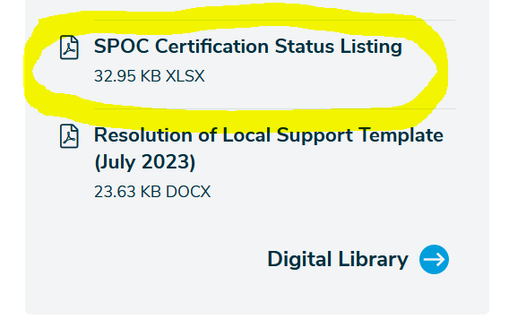
Federal Funding Administration
Caltrans Division of Local Assistance provides oversight of STBG on behalf of FHWA
  Find your Caltrans liaison: District 4
  Find your Local agency Single Point of Contact (SPOC):
  Contact your County Transportation Agency (CTA)
Local Assistance Procedures Manual (LAPM)
No match needed: MTC leverages toll credits to comply with federal matching requirements
In the left hand column, under "Related Documents"
Notes:
Cheryl
The Caltrans Division of Local Assistance is responsible for working with recipients of STBG and other federal and state transportation funds. Under the Headquarters unit, Caltrans is organized by Districts, or regions. Your agency is responsible for working with the Local Assistance to comply with Caltrans policies and procedures. The Bay Area is identified as Caltrans District 4. The hotlink will take you to the District 4 Local Assistance website: https://dot.ca.gov/caltrans-near-me/district-4/d4-programs/d4-transplanning-local-assistance/d4-office-of-local-assistance Here you can find your jurisdiction's contact here.
The Local Assistance Procedures Manual (LAPM) describes the required processes, procedures, documents, authorizations, approvals, and certifications to receive federal-aid and/or state funds for many types of local transportation projects. Caltrans and LAPM may be unfamiliar to you. To mitigate that situation, Caltrans and MTC require the designation of a Single Point of Contact (or SPOC) by each jurisdiction. This person must have sufficient knowledge and expertise in the federal-aid delivery process. They are responsible for working closely with FHWA, Caltrans, MTC and the respective CTA on all issues related to FHWA-funded projects. To get assistance with complying with Caltrans requirements, we recommend contacting your jurisdiction’s SPOC. They and the CTA would be good resources to meet the federal-aid requirements.
Image description: There is a screenshot from the linked MTC website directing agencies to find their Single Point of Contact. The screenshot is captioned “in the left hand column, under ‘related documents.’” The file labeled “SPOC Certification Status Listing” is highlighted. The MTC logo is seen in the lower left corner.

Slide 10
Federal Requirements
Set DBE Goal
Caltrans approval
Issue Procurement
Report on DBE Participation
Final DBE Report
Local agency responsible for working directly with Caltrans and reporting directly to Caltrans for DBE
Disadvantaged Business Enterprise (DBE) (LAPM Chapter 9)
Consultant Selection (LAPM Chapter 10): Cost estimate
Project Completion (LAPM Chapter 17): Final DBE Report
Notes:
Cheryl
PDA Grantees are responsible for working directly with Caltrans to meet the requirements identified in the LAPM. This slide highlights a few of the requirements and most relevant portions of the LAPM. Federal requirements (including DBE). Please note that DBE reports are not required at every invoice by MTC unless otherwise requested. We do require that grantees submit a final report at the end of the grant term (or when requested).
As subrecipients of United States Department of Transportation (USDOT) funding, Local Public Agencies (LPAs) are required to comply with and enforce certain nondiscrimination requirements in the award and administration of USDOT assisted contracts and procurements. The DBE Program is intended to ensure a level playing field and foster equal opportunity in federal-aid contracts. The DBE requirements only apply if you are contracting out the work. When setting a DBE goal, the local agency may use contract goals only on those federal-aid contracts that have subcontracting possibilities. (p 21, LAPM, Ch. 9)
If you are using consultants and a portion of that work can be subcontracted, your agency needs to establish a DBE goal for the contract. The goal would be submitted to Caltrans and they would review and approve. After approval, you would then issue the Request for Proposals (RFP) or Requests for Qualifications (RFQ). Some other steps to follow during and after consultant selection described in the chapter. Then report to Caltrans. Right now, MTC requests that we receive the final DBE report.
There is also training available through Caltrans and can found through the Division of Local Assistance webpage on the previous slide.
Now, I’ll pass it back to Manuel.
Image description: There is a graphic showing the linear process of Disadvantaged Business Enterprise reporting. The graphic reads as follows: set Disadvantaged Business Enterprise goal, Caltrans approval, issue procurement, report on Disadvantaged Business Enterprise participation, final Disadvantaged Business Enterprise report. The MTC logo is seen in the lower left corner.

Slide 11
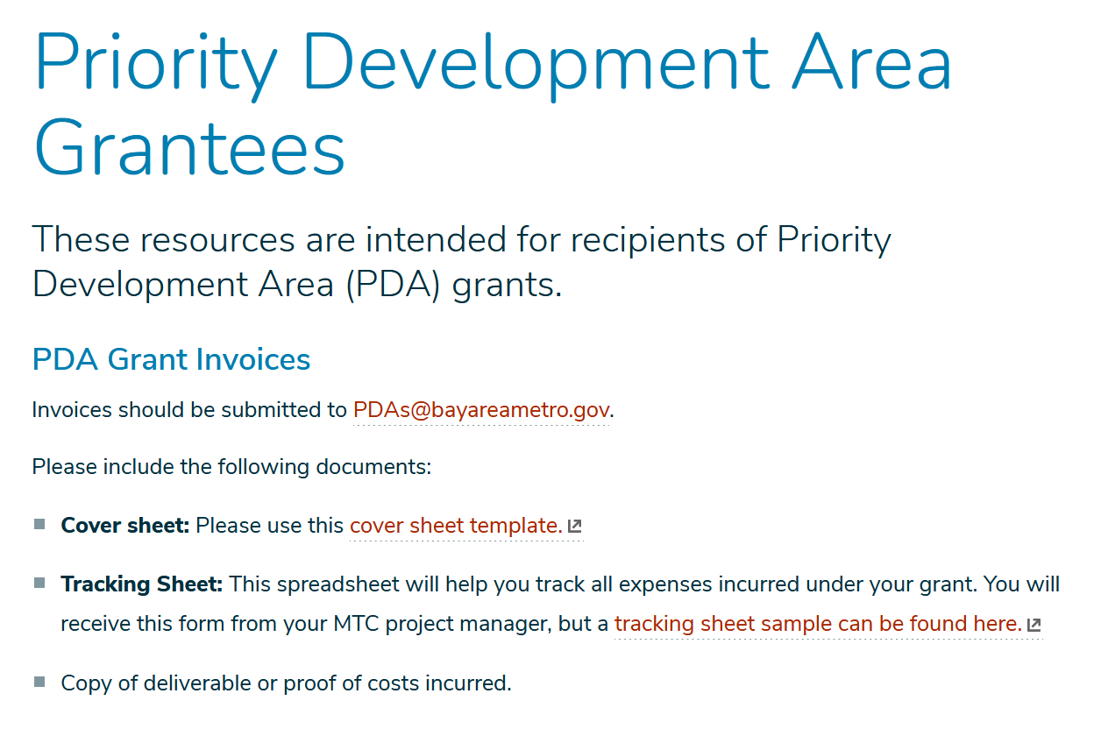
Invoicing & Close-Out
https://mtc.ca.gov/pda
Notes:
Manuel
The next section covers invoicing and closing out grants.
Image description: The MTC logo is seen in the lower left corner.

Slide 12
Invoicing
Cover letter (use template)
Include payment tracking sheet (to be provided by MTC)
Include deliverables
Report DBE participation to Caltrans
Submit to PDAs@bayareametro.gov
Execute Agreement
Submit invoices and deliverables
Grant closeout
Begin reimbursable work
Notes:
Manuel
Once an executed MFA and supplement are in place, work under this grant may begin. Please remember to refer to the scope of work and schedule section of the agreement for guidance on what deliverables are reimbursable under your grant and when MTC staff expect to receive them by.
We will be sending you all a cover sheet template that you are welcome to use for all invoices under this grant. Instructions for filling it out can be found in the comments but please do not hesitate to reach out to us at PDAs@bayareametro.gov if you have any questions. When invoicing, you will need to include the cover sheet summarizing the funds being requested, copies of each deliverable you are requesting reimbursement for, and a payment tracking sheet which we will also be providing to you. All invoices and invoicing materials should be sent to PDAs@bayareametro.gov. Let us know immediately if you have any changes to your mailing address for payments.
Please also note that while DBE participation does not need to be reported to MTC with each invoice, local agencies should still be reporting on their DBE participation directly to Caltrans.
As we proceed towards the end of your grant term, we can move towards closing out the grant.
Image description: There is a green graphic describing the invoicing process. The linear process reads as follows: execute agreement, begin reimbursable work, submit invoices and deliverables, grant closeout. The MTC logo is seen in the lower left corner.

Slide 13
Project Changes and Closeout
Changes
Please contact your MTC PM to discuss changes to scope, budget, or timeline.
Closeout
Invoice within 30 days of project end date
Provide DBE Report
Submit Plan Summary (include in consultant SOW)
Notes:
Manuel
Please contact your MTC project manager to discuss any changes to scope, budget, or timeline.
All invoices must be submitted within 30 days of project end date. Please note that you will also need to provide a final DBE report at the conclusion of the grant term. You will also need to submit a Plan Summary (which should be included in the consultant’s scope of work).
Image description: The MTC logo is seen in the lower left corner.

Slide 14
Consolidated Listing of Resources
Plan Bay Area 2050
PDA Planning Element Requirements
Transit-Oriented Communities (TOC) policy
One Bay Area Grant Program
Caltrans Division of Local Assistance
  District 4 Local Assistance webpage and contacts
  Local agency Caltrans Single Point of Contact (SPOC)
  Local Assistance Procedures Manual (LAPM)
Notes:
This page provides a consolidated listing of many of the hotlinks shared in the presentation.
Image description: The MTC logo is seen in the lower left corner.

Slide 15
Questions?
Administrative: PDAs@bayareametro.gov
Ada Chan (Project-related): achan@bayareametro.gov
Visit mtc.ca.gov/pda for more information
Notes:
That concludes our PDA Orientation. We will stop recording now and open it up for questions.
Please email PDAs@bayareametro.gov for administrative PDA questions. You may email Ada Chan for project-related questions at achan@bayareametro.gov.
Visit mtc.ca.gov/pda for more information.
Image description: The MTC logo is seen in the lower left corner.

